Slide 1

Students Marks Prediction
Pratik Khanna

Slide 2

Importing Libraries

Slide 3


Student Data

Slide 4
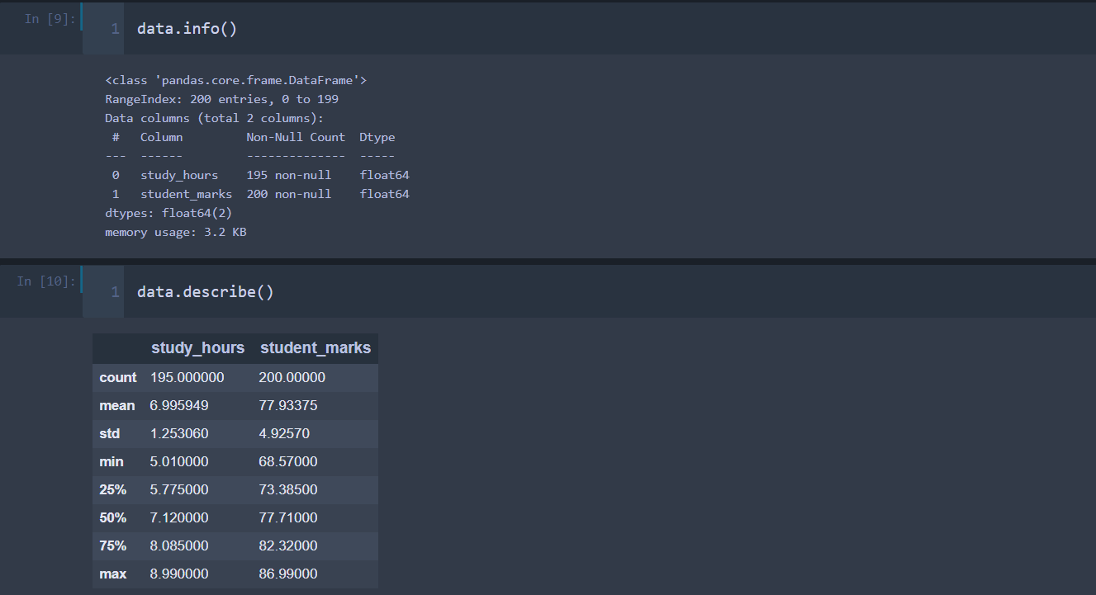
Understanding the Data

Slide 5
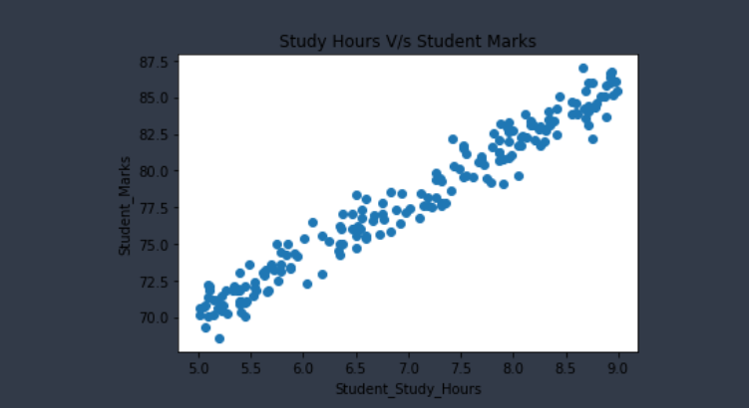
Visualization

Slide 6
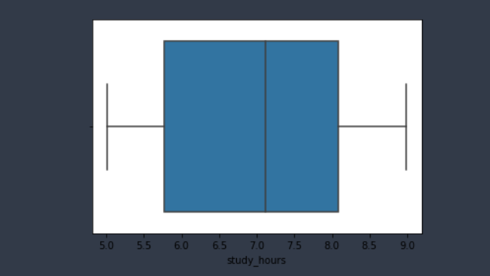
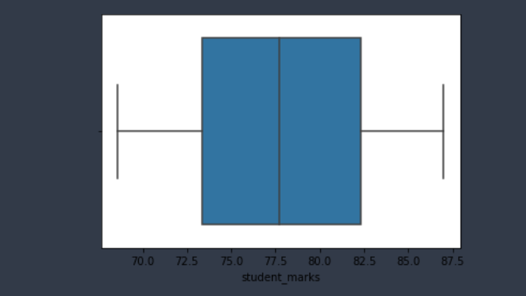

Slide 7
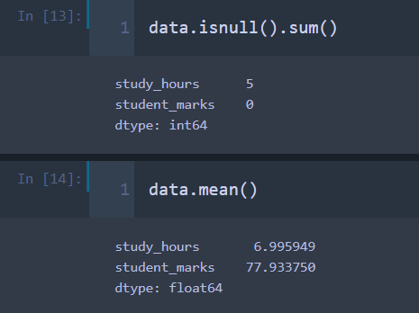
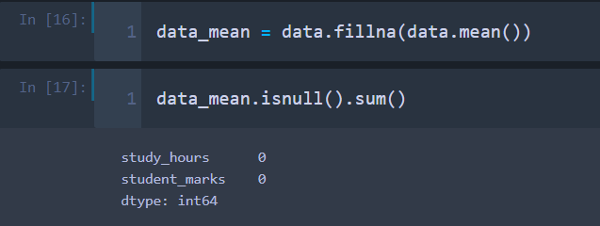
Missing Value Treatment

Slide 8
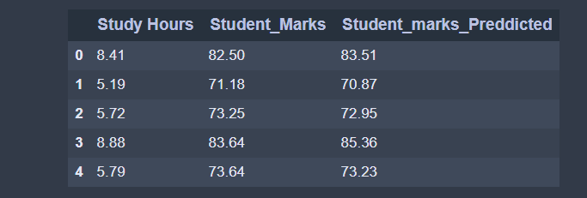
Model Building

Slide 9
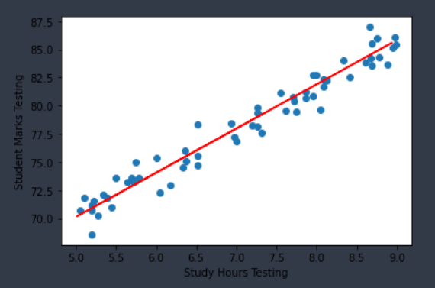
Scatter Plot X_test V/s y_test

Slide 10


R-Square

Slide 11

Flask Application

Slide 12

Flask Application

Slide 13
Thank You

